Slide 1
Clustering
Student Numbers:
Matthew Kruger 1669326
Jared Harris-Dewey 1846346
K-Mean Clustering
C-Means Clustering

Slide 2
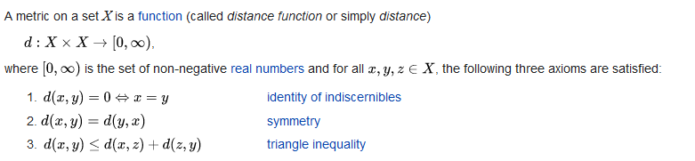
Metric

Slide 3
K-Mean Clustering
Background?
Soft vs Hard Clustering Algorithm
Datapoints assigned to multiple clusters
Datapoints assigned to a single cluster
Problem Domain:
Aims to segment N datapoints into K Clusters
Image Compression
Machine Learning
NP-Hard Problem

Slide 4
K-Mean Clustering
Parallelisation?
Serial
Slow, repetitive process that can be parallelised.
CUDA
Idea:
Each thread gets datapoint.
Each thread gets cluster.
Open MPI
Idea:
Split datapoints between nodes

Slide 5
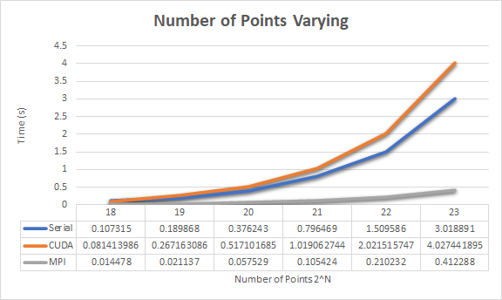
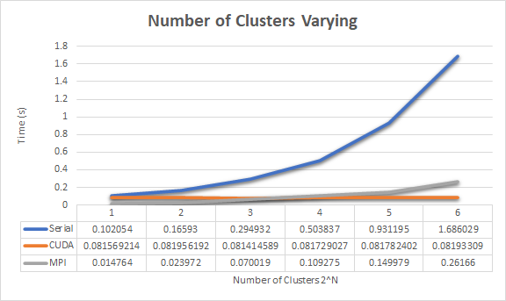
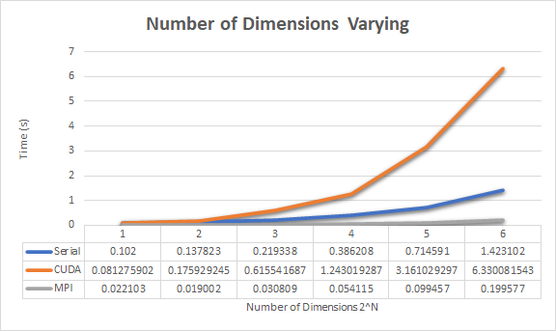
K-Mean Clustering

Slide 6
Code
Make
Sbatch jobscript
Output

Slide 7
Fuzzy C-Means Clustering
Computationally very expensive given number of data points, centroids, dimensions and completion criteria.
More computational complexity created through use of power functions and square roots.
Distance metrics are very important.

Slide 8
Fuzzy C-Means Clustering
1) Randomly select C cluster centers.
2) Repeat
a. Calculate the fuzzy membership for each data in the cluster.
b. Compute the centroids for each cluster
Steps a & b are repeated until some criteria is met, often an acceptable error tolerance.
This allows for use of parallel programming methods to speed up the computation.
CUDA: Each cluster calculated by a thread. Spawn as many threads as possible and get them to update observations in parallel.
Open MPI: Each processes updates a set number of observations. We calculate partial sums of our centroids as they update & the master thread updates the centroids and informs the rest.

Slide 9
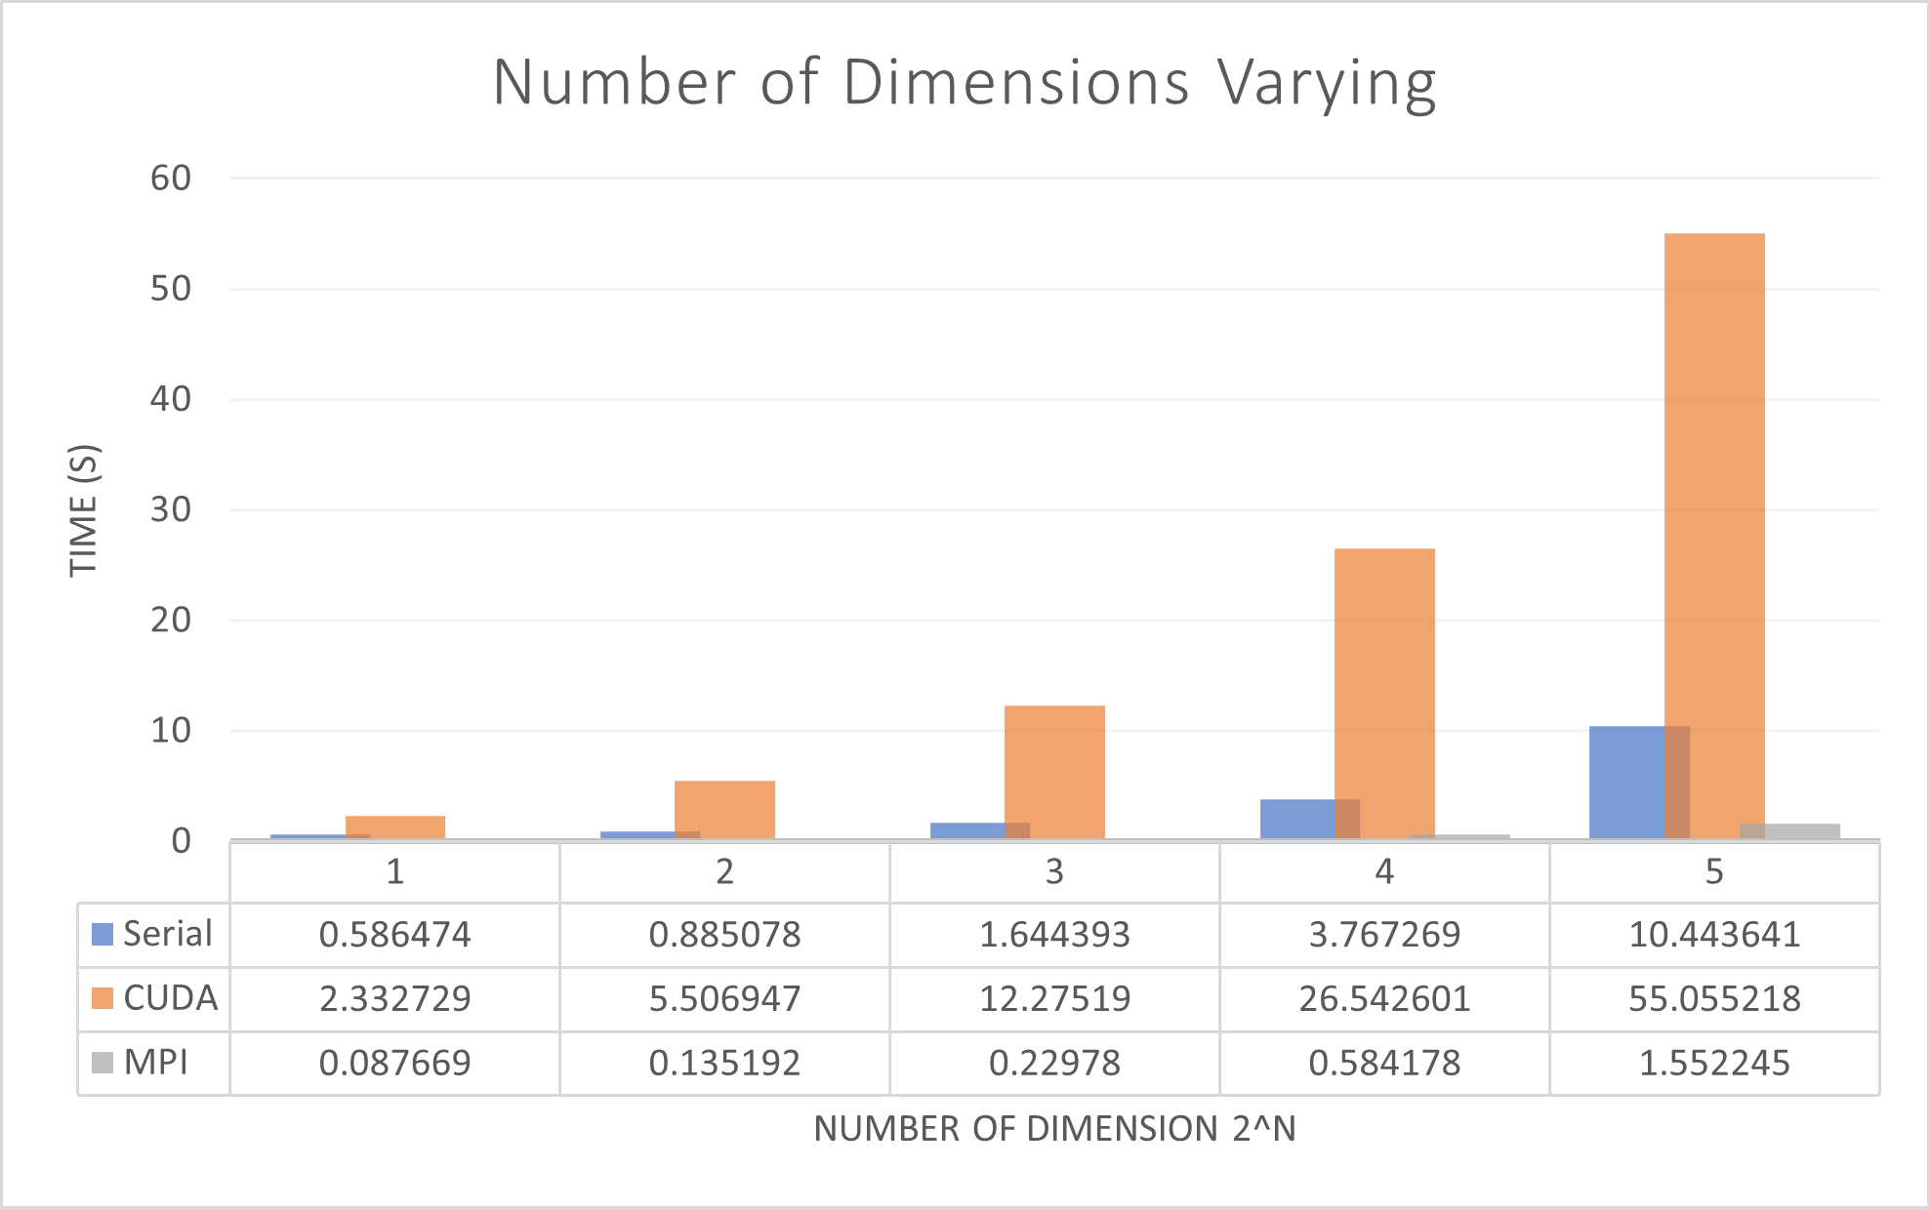
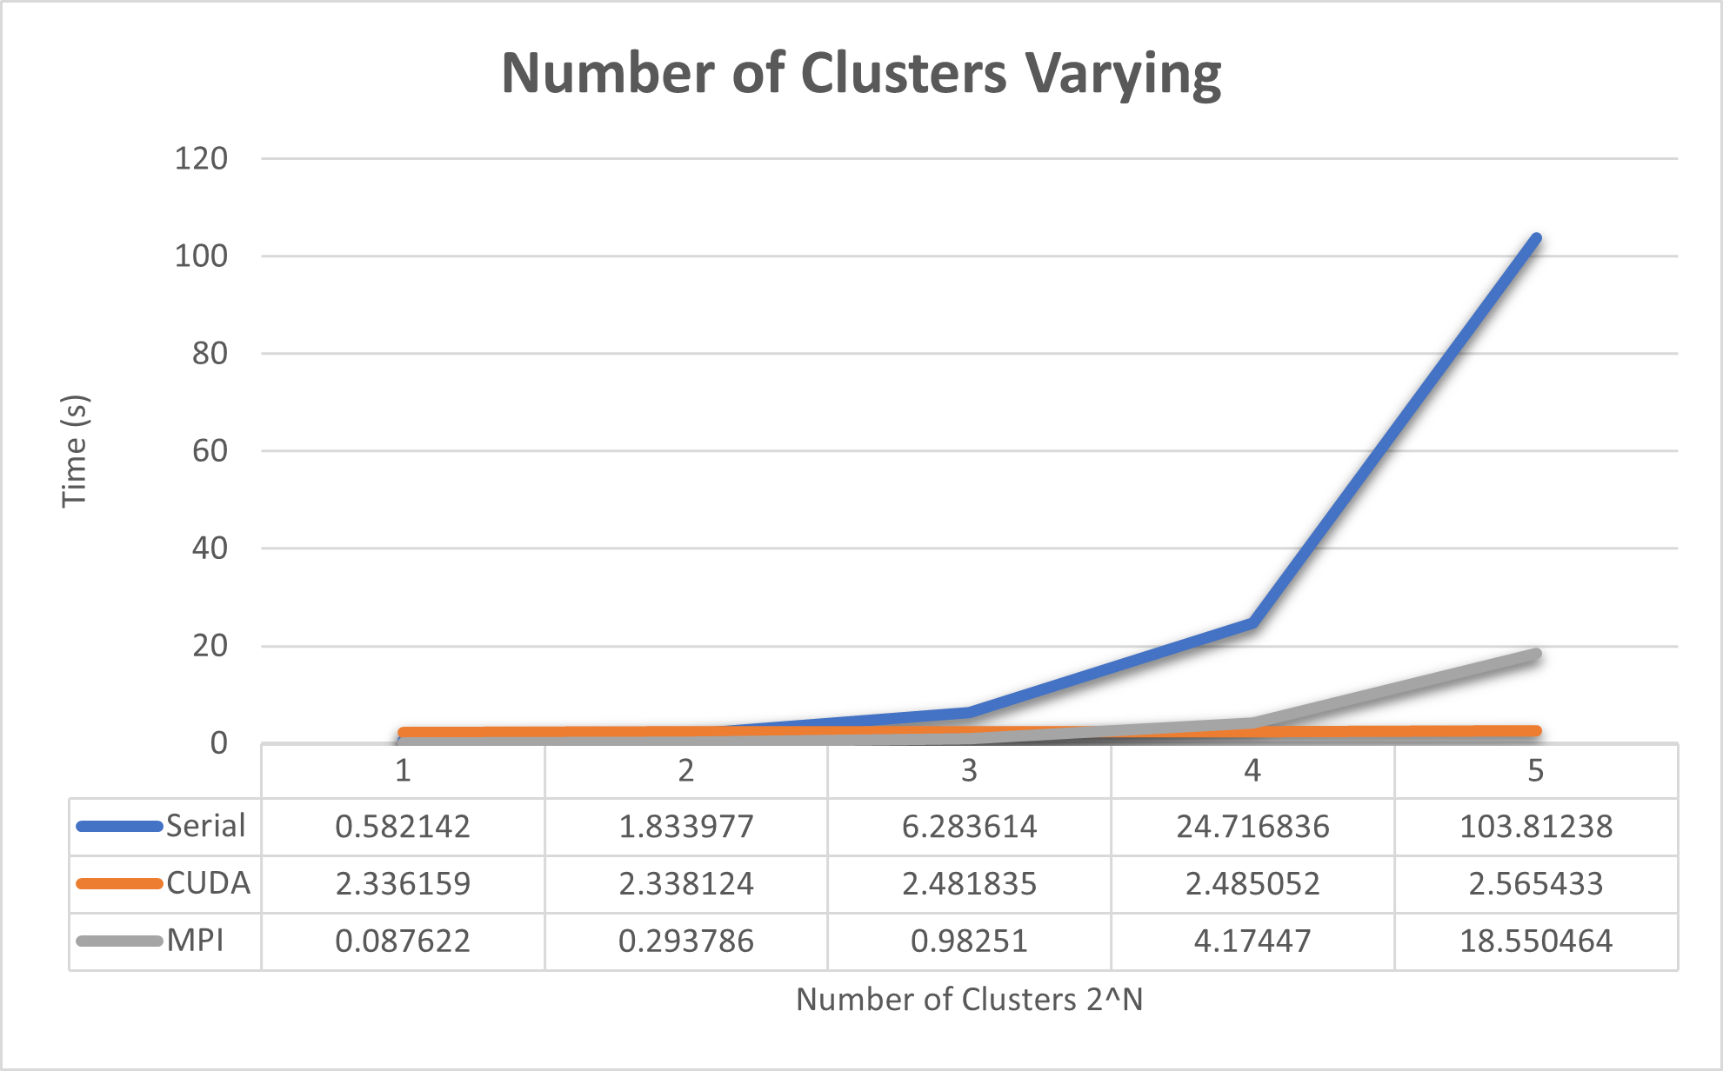
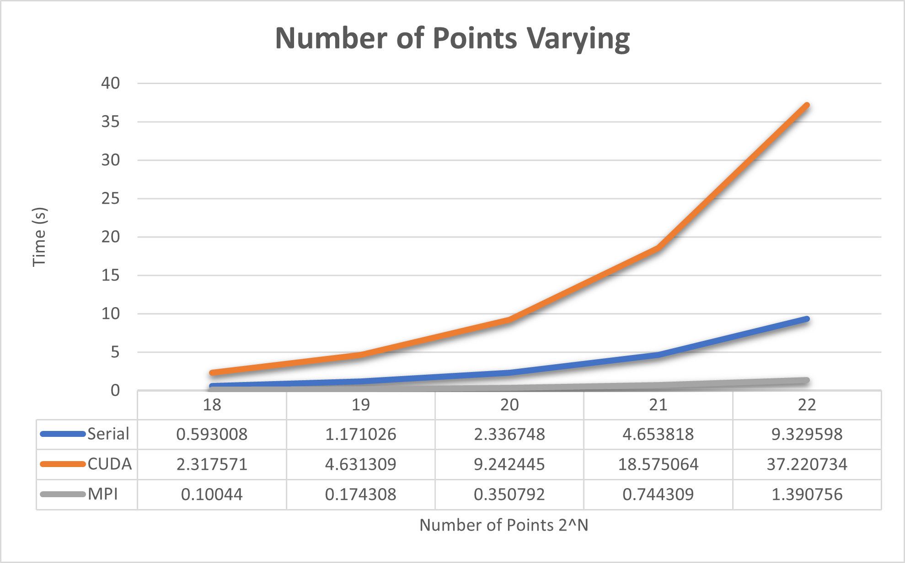
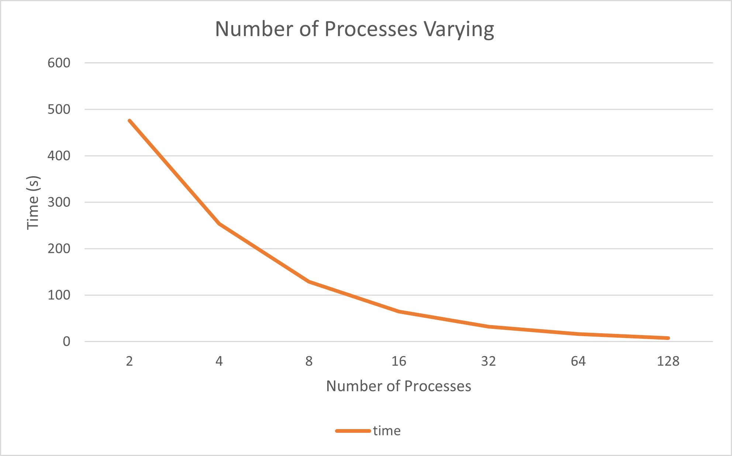
Fuzzy C-Means Clustering

Slide 11
Code
Make
Sbatch jobscript
Output

